Slide 1
GIT Installation
With Basic Commands

Slide 2
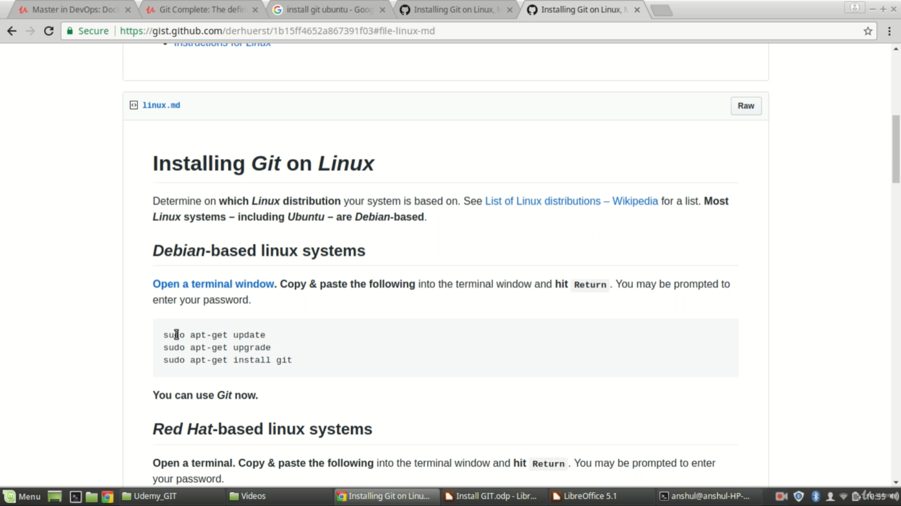
INSTALLING GIT IN LINUX
We can download and install Git from the above website for Linux environment

Slide 3
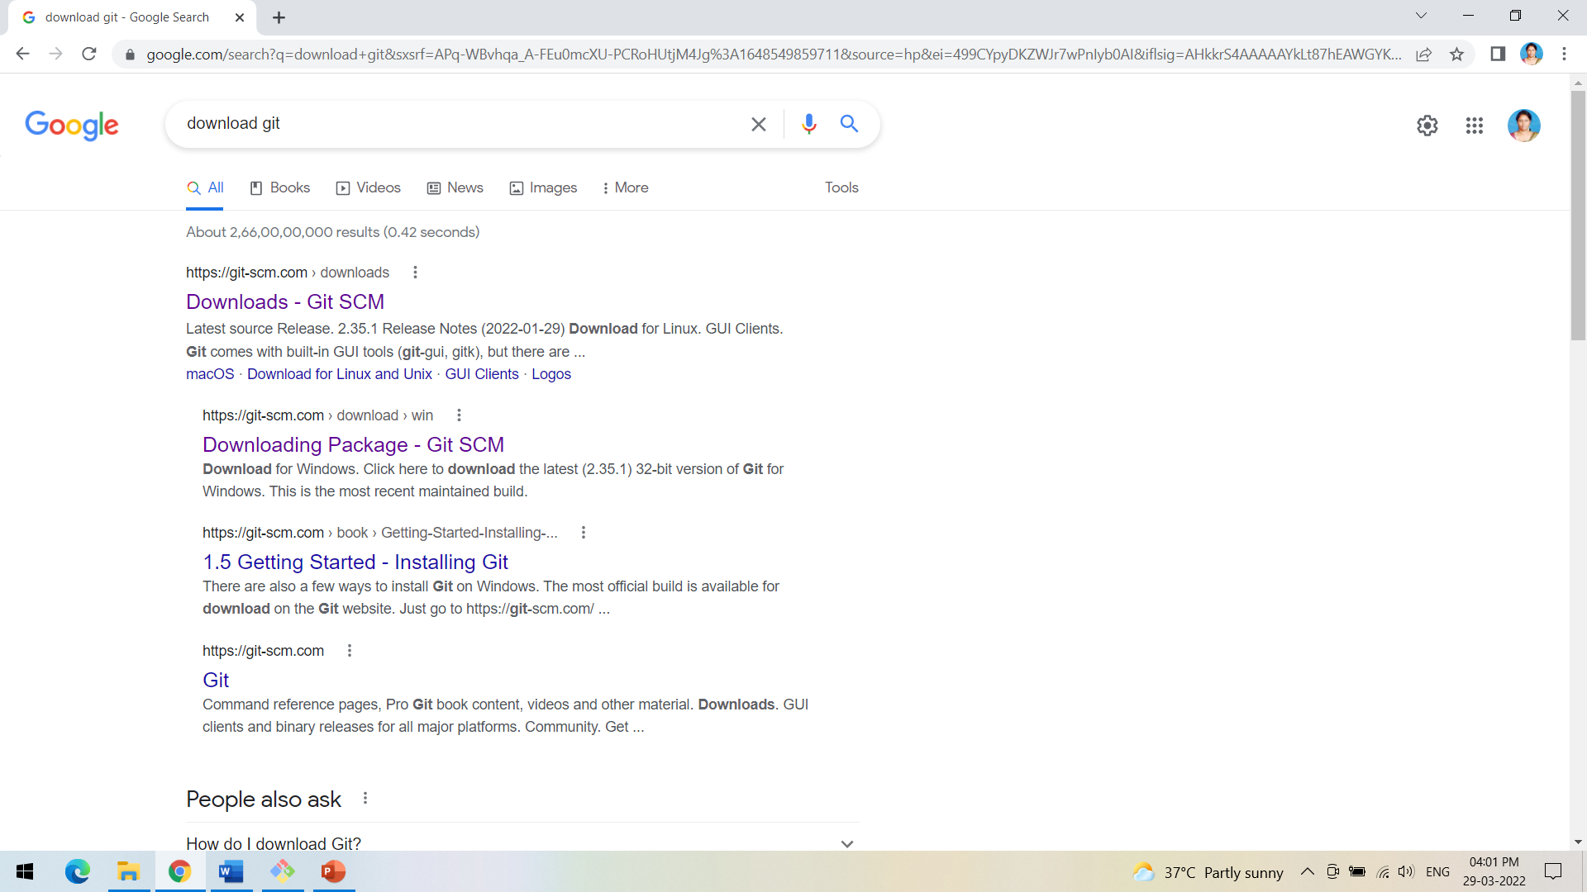
INSTALLING GIT IN WINDOWS
We can type download git from google.com and click on the first link Git SCM

Slide 4
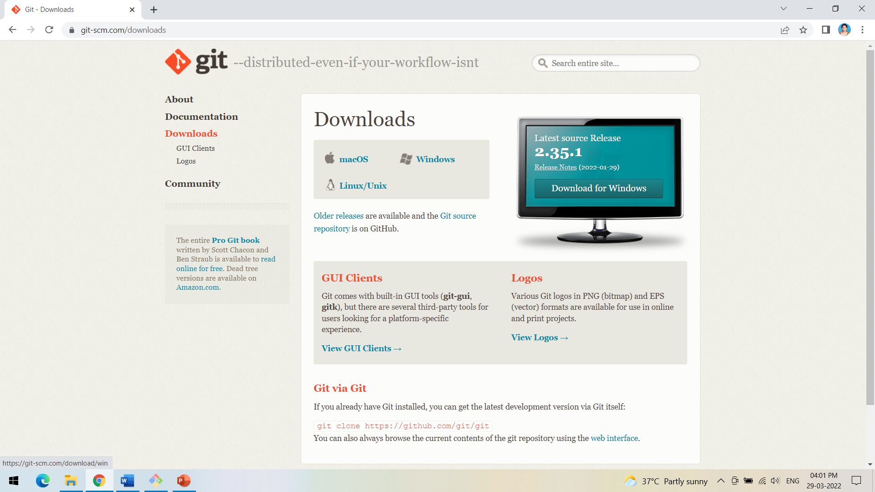
INSTALLING GIT IN WINDOWS
Select the Git software for the required OS.

Slide 5
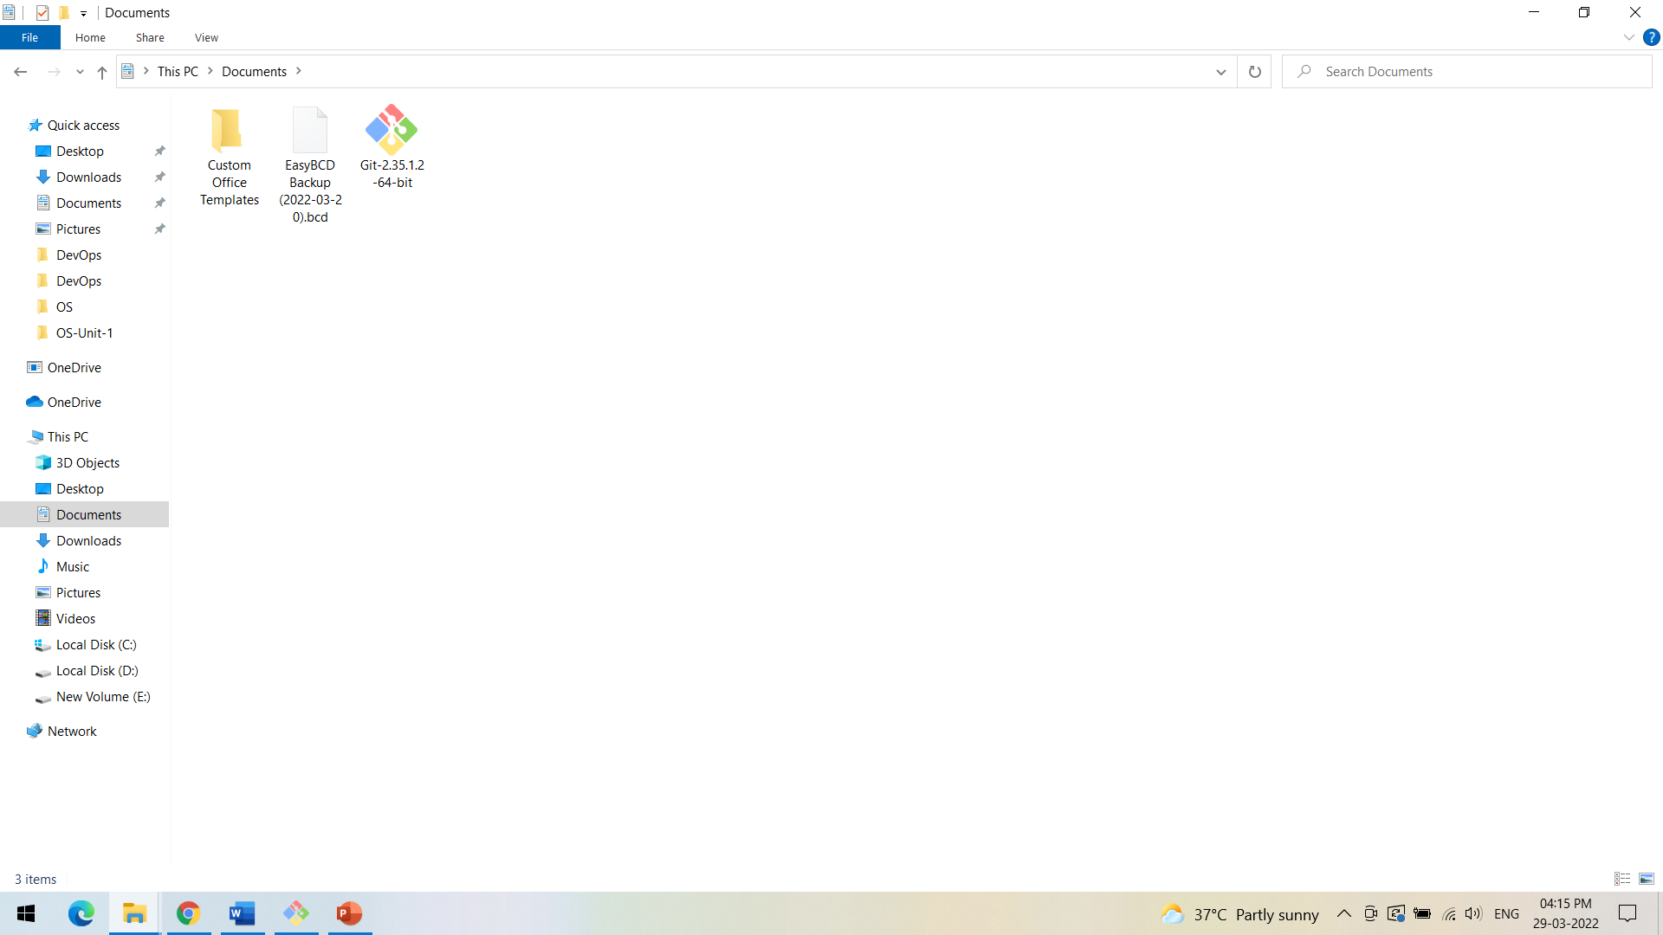
INSTALLING GIT IN WINDOWS
Install the Git software downloaded.

Slide 6
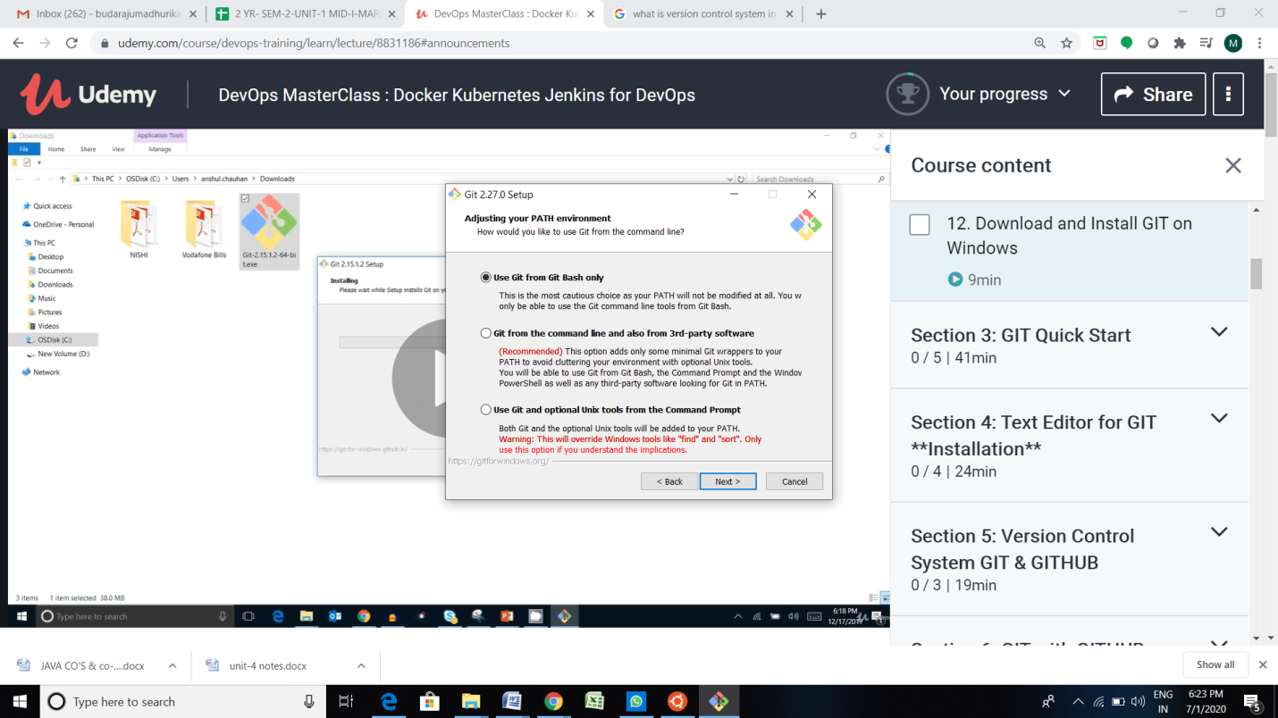
INSTALLING GIT IN WINDOWS
While installing select the option Use Git from Git Bash only option and click Next.

Slide 7
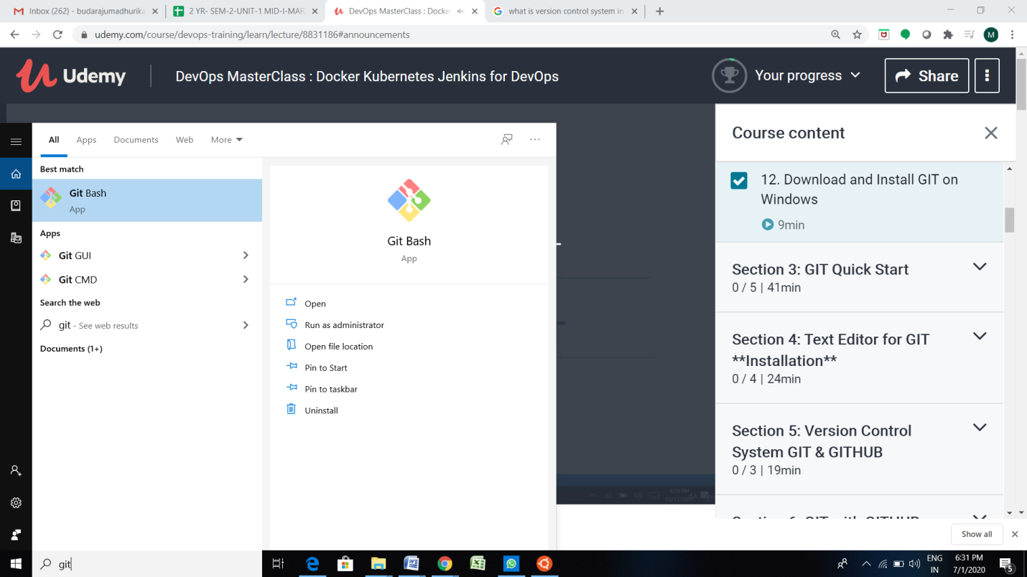
INSTALLING GIT IN WINDOWS
In the start, you will now find the Git Bash after successful installation.

Slide 8
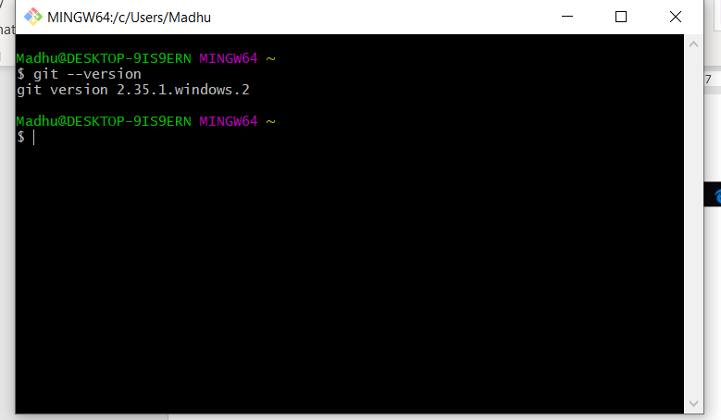
INSTALLING GIT IN WINDOWS
Follow this command to know the version of Git.

Slide 9
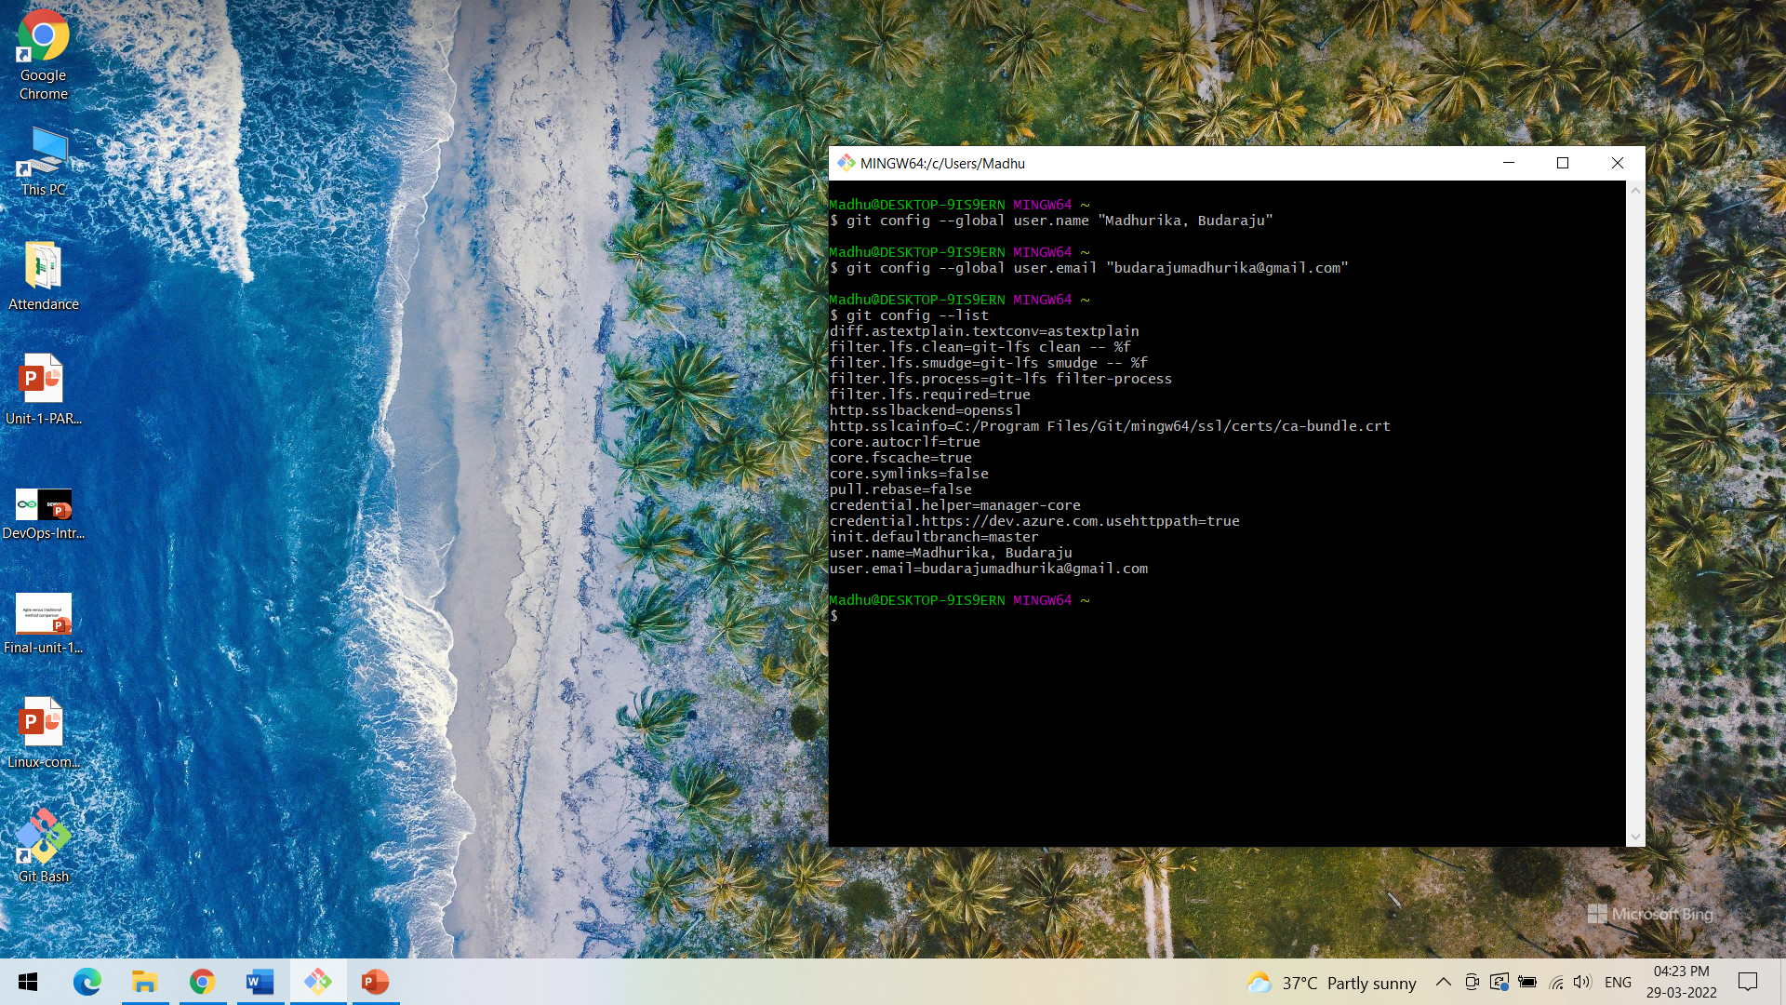
INSTALLING GIT IN WINDOWS
WE CAN CONFIGURE OUR NAME AND EMAIL IN GIT,
In personal computer it is not required to configure but in corporate company we have to configure user information in GIT as we will have random value in the user name as GIT will be installed in several machines and it will be using the machine ID, we will not be able to understand who has performed changes with random id, so better configure.

Slide 10
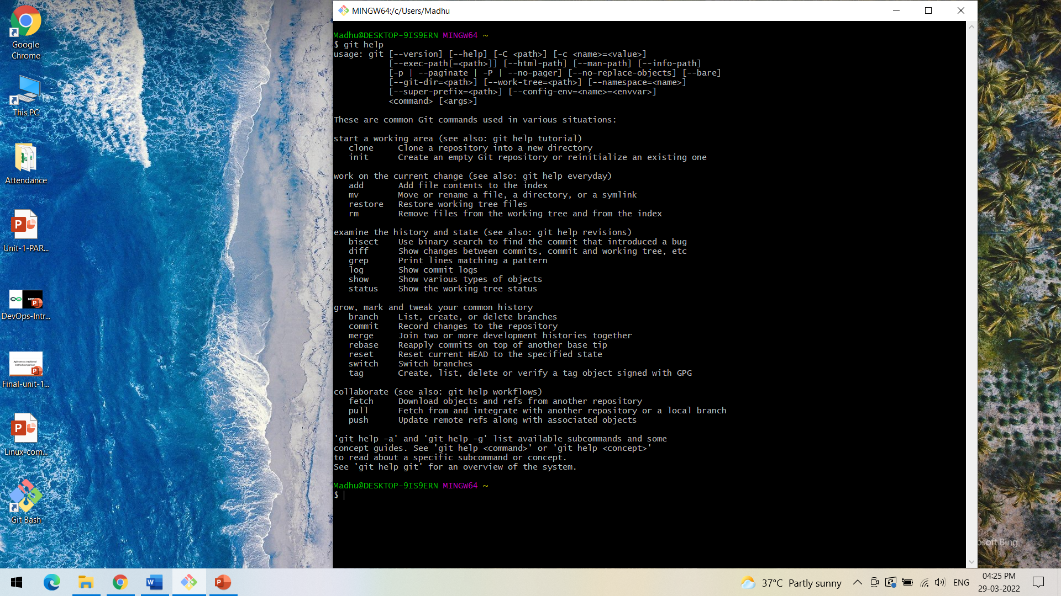
INSTALLING GIT IN WINDOWS
If we want to know the various commands in GIT, type git help

Slide 11
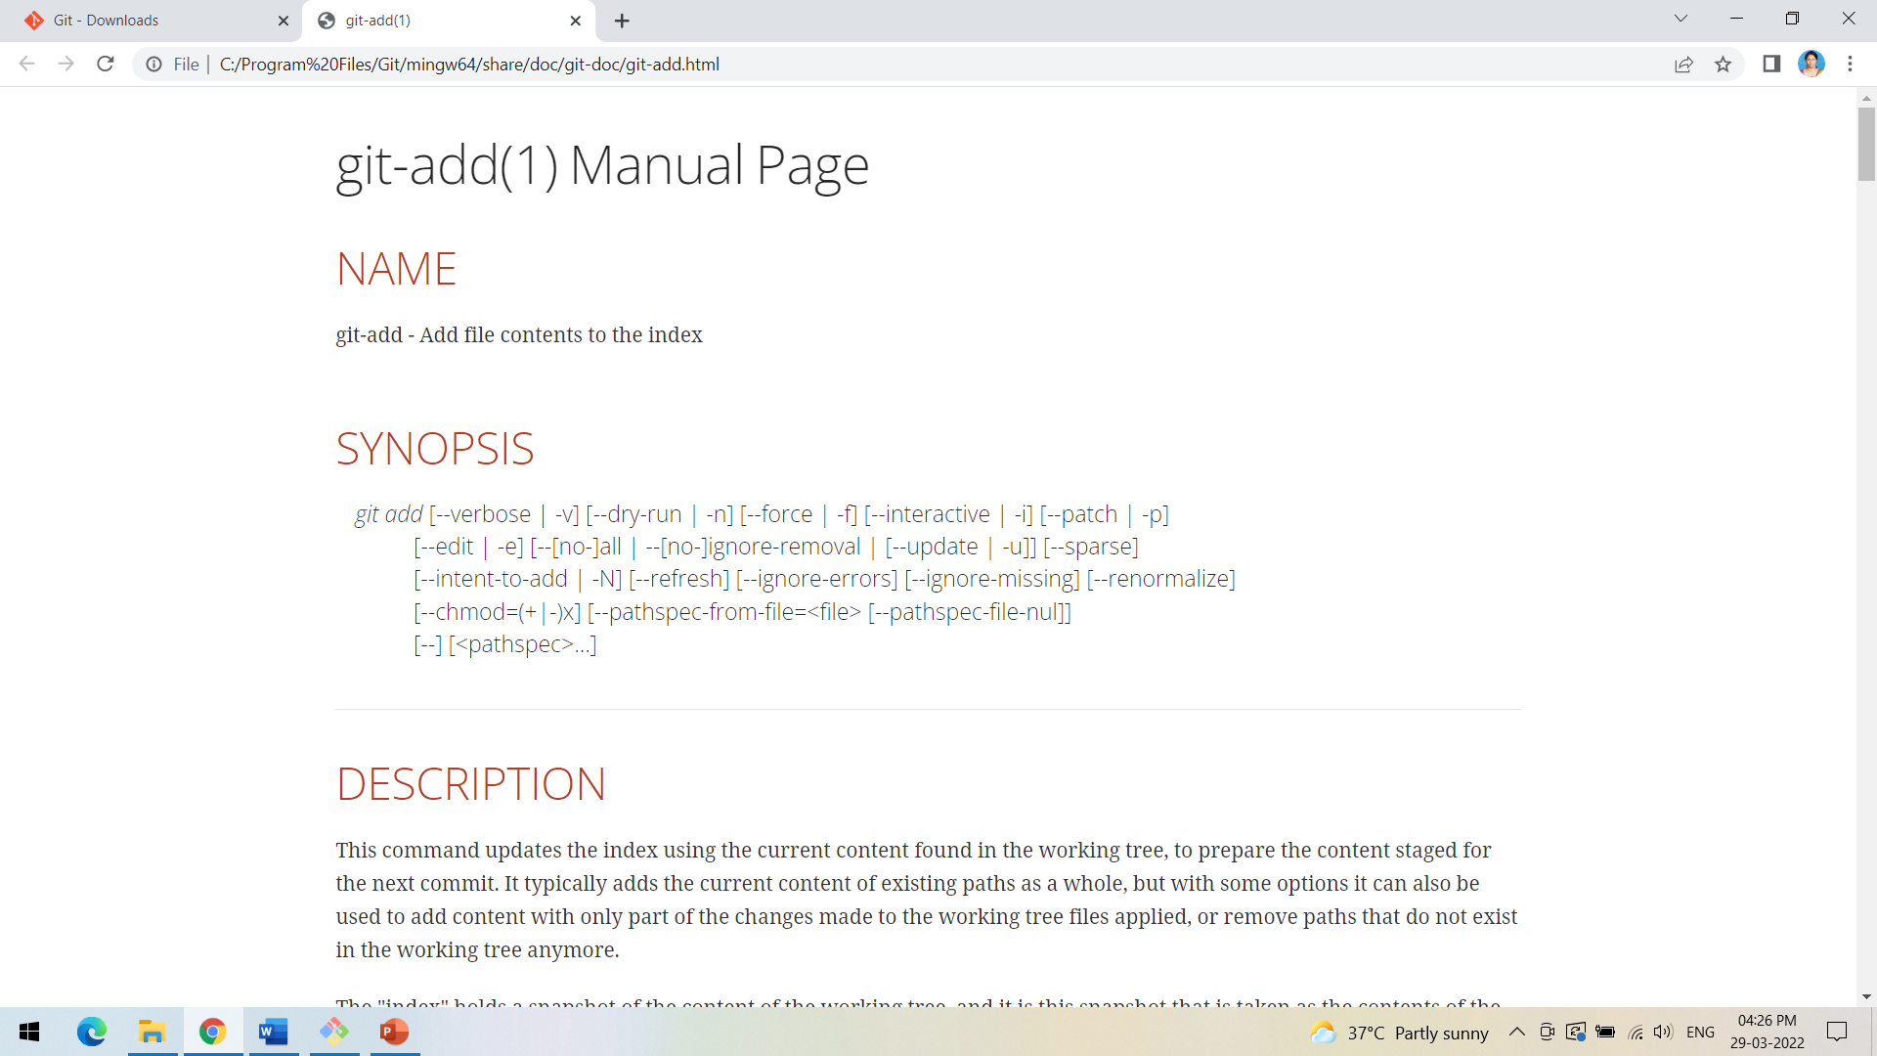
INSTALLING GIT IN WINDOWS
To know in detail about any command type git help command_name e.g. git help add

